Slide 1
A Novel Approach for Identifying Collisional Asteroid Families in the Kuiper Belt
Aditya Kendre

Slide 2
What is a Collisional Family?
Very little is known about the formation of the Kuiper belt - a circular disc containing KBOs (Kuiper belt objects) located approximately 50 AU from the sun, and the origin of like belts surrounding many similar solar systems. The identification collisional asteroid families - asteroid families endured a collision between multiple objects creating a cluster of KBOs similar in orbital features, has led to the recent discovery of the Haumea asteroid family. This has shed light on the physical processes that have otherwise been neglected e.g., Yarkovsky effect. Furthermore, many new research paper establish the idea that various asteroid collisional families located in the Kuiper belt have traveled to other various parts of the solar system, because the intensity of the collisions have caused major deviations in object velocities. Hence, may Kuiper belt objects have contaminated the both the Main Asteroid belt and the Scattered disk. Discovering the parent bodies of pervious collisions and determining the aftermath would aid in wider knowledge of the evolution and formation of the Kuiper belt. May scientist have disregarded the importance of understating the orbital distributions of KBOs, as the Kuiper belt has mostly been around since the formation of this solar system. Understating the physical properties of these KBOs are essential in understanding the physical of the other regions of solar systems, considering that most solar systems have many asteroid belts.

Slide 3
Question
Can the Haumea asteroid collisional family can be distinguished from the background objects in the Kuiper belt, and which clustering techniques and/or algorithms are the most efficient in identifying the Haumea family? Can these techniques be used to distinguish other families?

Slide 4
Hypothesis
Collisional families located will be able to be distinguished from background objects in the Kuiper belt, and the Hierarchical Clustering method will be the most efficient way in distinguishing the Haumea asteroid collisional family from the background objects in the Kuiper belt.

Slide 5
Methods
Proper Orbital Elements Calculations
This process involves calculation the values of an asteroids position and/or orbit.
Hierarchical Clustering Algorithm
Most common algorithm used for identification of collisional families.
Proper Orbital Elements Plotted
This is was used for visually plotting the data to identify any abnormalities without any analysis.
Result Analysis
Analyzing if the algorithms were efficient at identifying collisional families.
K-means Clustering Algorithm
Simple and fast algorithm used for identification clusters in huge datasets.

Slide 6
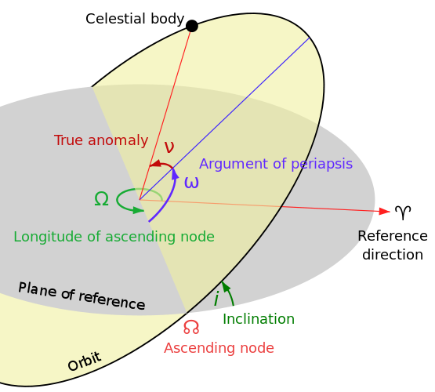
Proper Orbital Elements Calculations
Eccentricity (e) – elliptical shape of the orbit, described in a range between 0 – 1, where 0 is a perfect circle
Semi-major axis (a) – greater distance from center of an ellipse to the outer.
Inclination (i) – the vertical tilt of the orbit
Eccentricity (e)
Semi-major axis (a)

Slide 7
Proper Orbital Elements Calculations (cont.)
Dataset:
AstDyS provides information on numbered asteroids with a convenient Web-based interface. It is based on a continually and almost automatically maintained database of asteroid orbits.
Name of Object | a | e | i
15760 | 43.9801085 | 0.0703557 | 0.0439968
15789 | 39.4583336 | 0.1841545 | 0.1019159
15807 | 43.7982074 | 0.0729767 | 0.0330139
15809 | 42.3286792 | 0.2202312 | 0.2244278
15810 | 39.4609541 | 0.1247105 | 0.0599178
15836 | 36.4850721 | 0.0712616 | 0.0857137
…
2015RS24 | 8.22 | 40.4187896 | 0.0988933
2015UK84 | 49.6112986 | 0.247131 | 0.3800829
2016BP81 | 43.7265793 | 0.064597 | 0.0616415
2016FP59 | 46.6368753 | 0.1604549 | 0.090706
2016FW59 | 43.4338484 | 0.0762106 | 0.142732

Slide 8
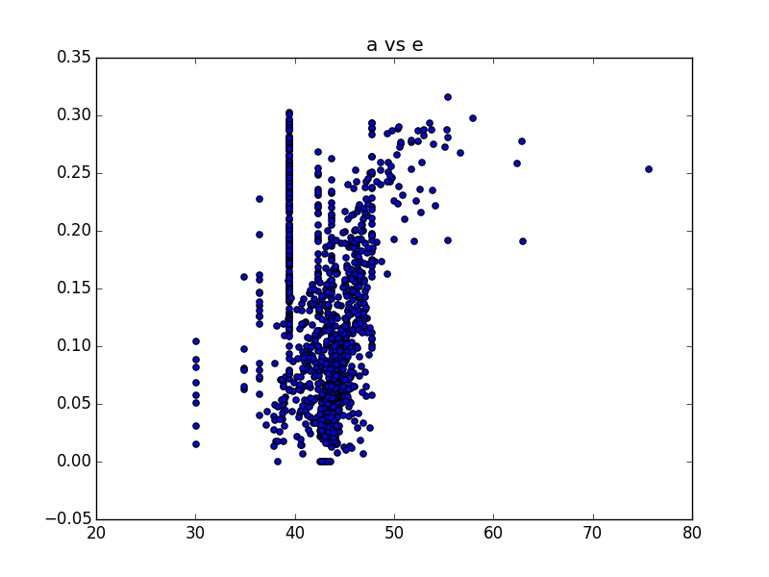
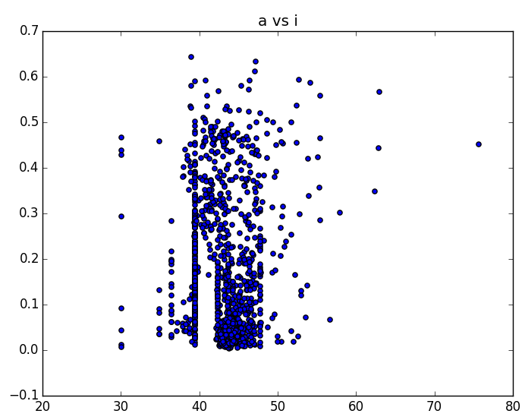
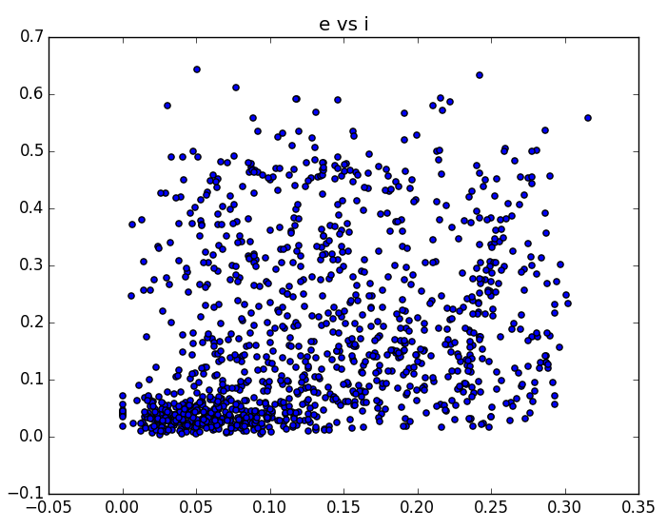
Result: Proper Orbital Elements Plotted
The lines seen in the graphs ‘a vs e’ and ‘a vs i’, are called resonances. Resonances are created when the ratio of an object’s orbit and the orbit of Neptune match up, the object becomes synchronized with Neptune’s gravity. Therefore, the reason why plots graphed with ‘a’ (semi-major axis) display resonances.

Slide 9
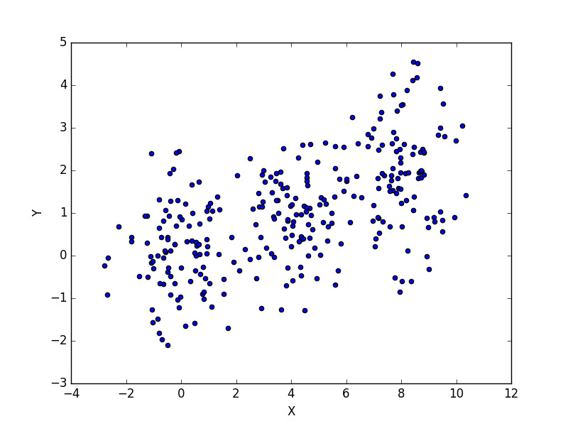
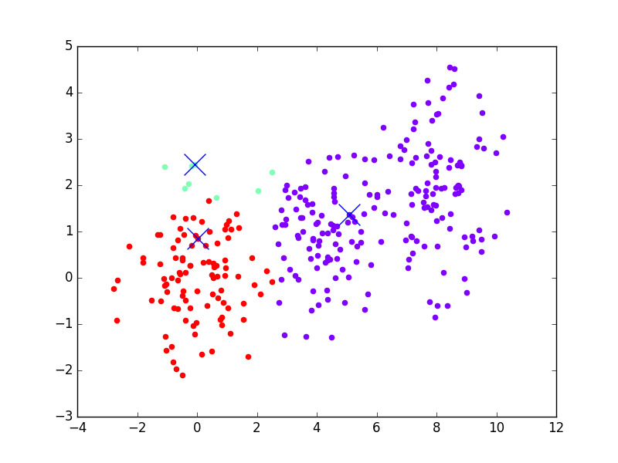
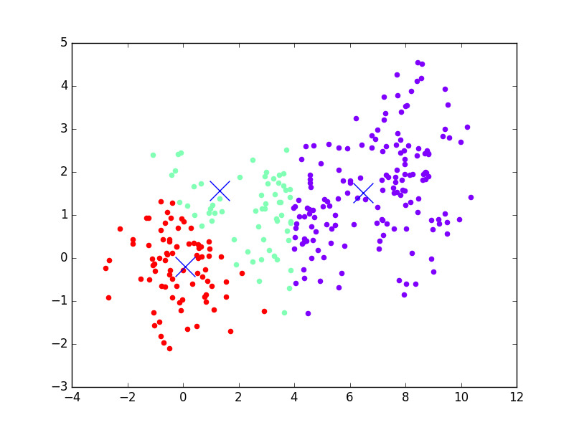
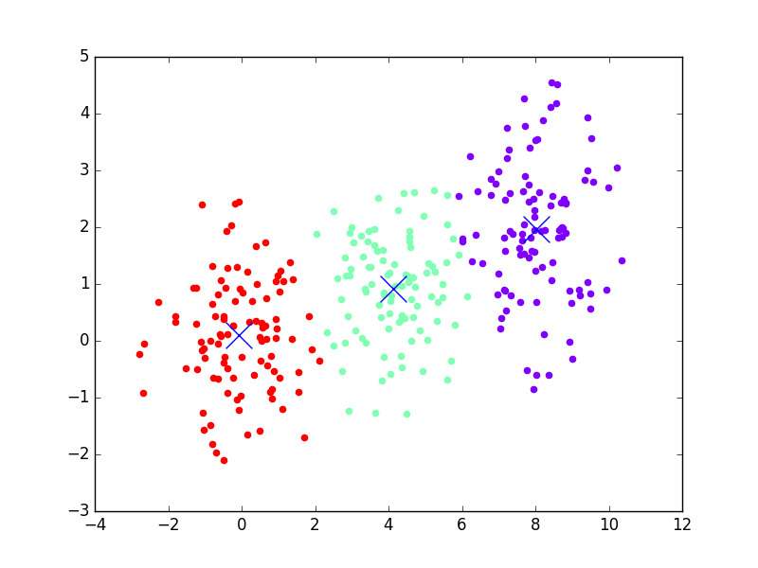
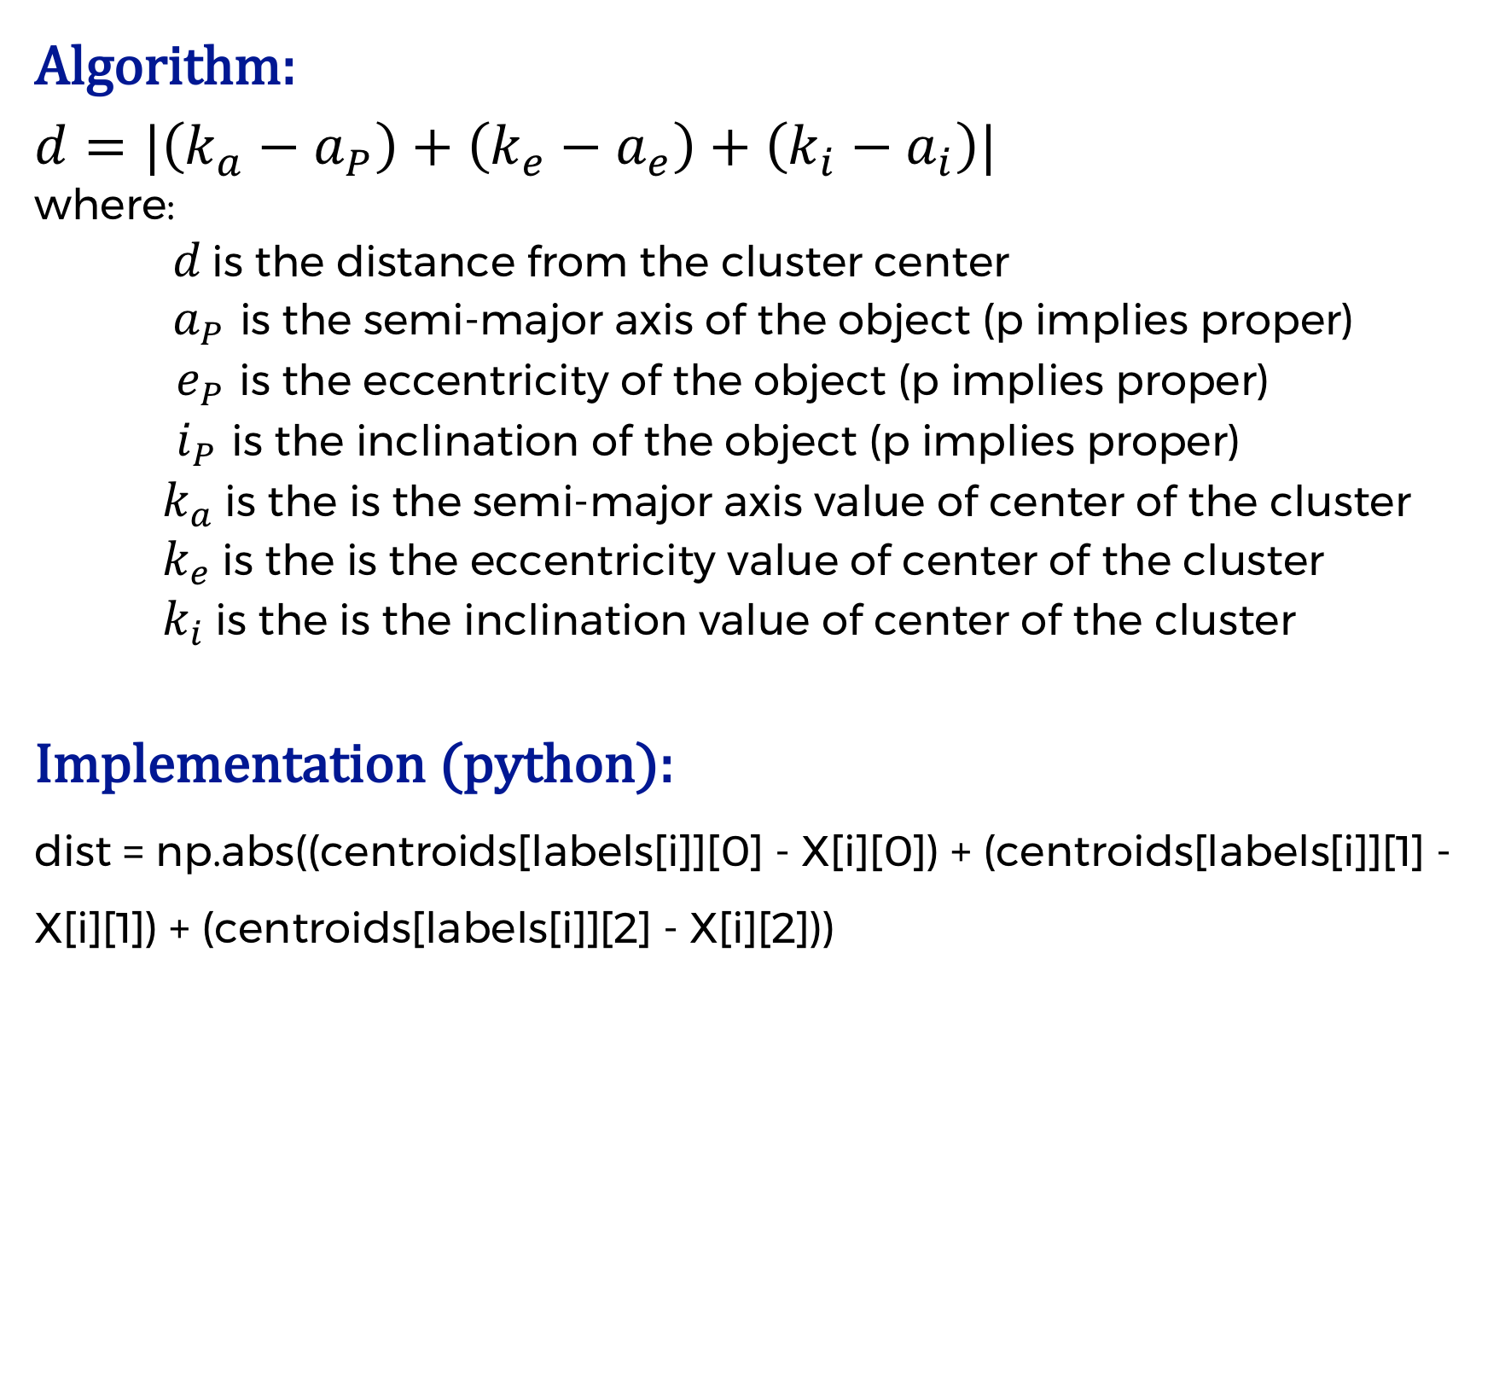
K-means Clustering Algorithm
Expiation:
In a center based algorithm, the number of clusters (k) are predefined. The clusters start out at random positions on the graph, the clusters are then moved to and adjusted until each object’s distance from the cluster’s center is the closest to itself. This iteration is repeated until all objects are located in the cluster closest to their position.
Example:
Algorithm:
$$d=|\left(k_{a}−a_{P}\right)+\left(k_{e}−a_{e}\right)+\left(k_{i}−a_{i}\right)|$$
where:
$d$ is the distance from the cluster center
$a_{P}$ is the semi-major axis of the object (p implies proper)
$e_{P}$ is the eccentricity of the object (p implies proper)
$i_{P}$ is the inclination of the object (p implies proper)
$k_{a}$ is the is the semi-major axis value of center of the cluster
$k_{e}$ is the is the eccentricity value of center of the cluster
$k_{i}$ is the is the inclination value of center of the cluster
Implementation (python):
dist = np.abs((centroids[labels[i]][0] - X[i][0]) + (centroids[labels[i]][1] - X[i][1]) + (centroids[labels[i]][2] - X[i][2]))
Iteration 1
Iteration 2
Iteration 3
Iteration 4
Notes:
Mostly used for main belt, recently used for Kuiper belt. Advantage over other clustering algorithms, like k-means clustering algorithm

Slide 10
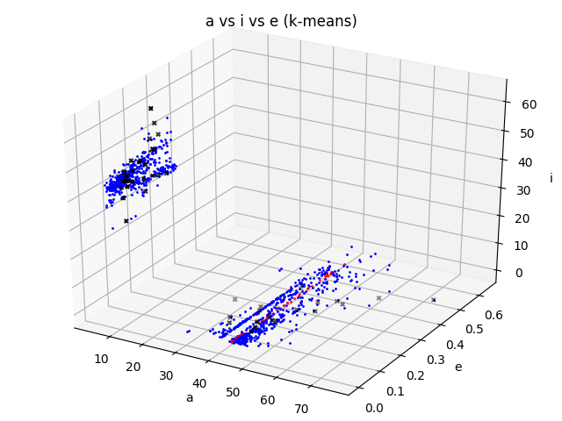
Result: K-means Clustering Algorithm
This method looks promising; however, taking a closer look, many clusters are are just common groupings loosely based on the distance from objects. Hence, most clusters are just created by random chance. This can bee seen as many members of the Haumea family are scatter around in different clusterings.
Objects that are both found in the cluster and in the Haumea family
Object | Distance form center
19308 | 0.330731959129501
55636 | 0.29394256975858585
120178 | 0.2820518868809836
145453 | 0.2915599092512587
308193 | 0.36074165447900486
‘x’ makes are the centers of clusters
The points in red are objects that are grouped containing the planet Haumea.
Notes:
Mostly used for main belt, recently used for Kuiper belt. Advantage over other clustering algorithms, like k-means clustering algorithm

Slide 11
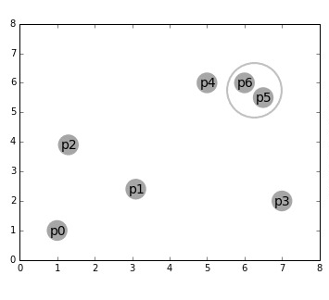
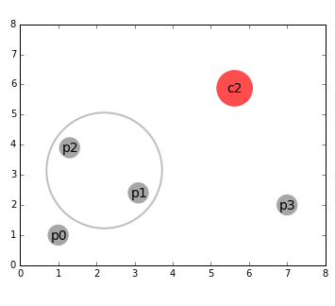
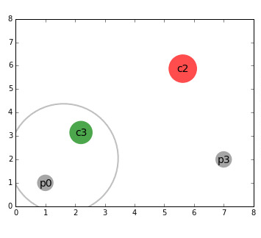
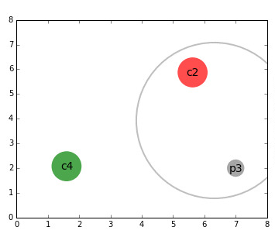
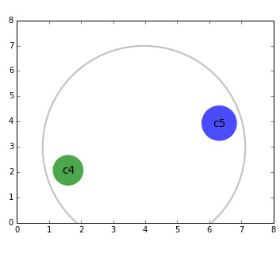
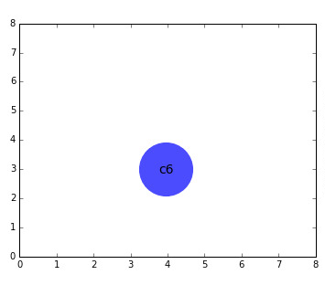
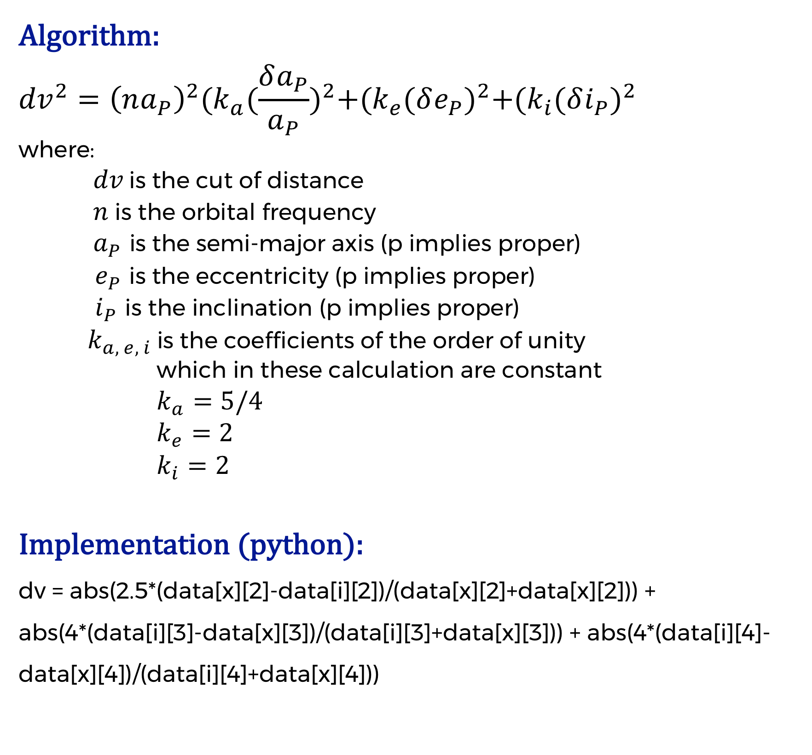
Hierarchical Clustering Algorithm
Expiation:
This algorithm is based on the idea that objects closer in distance are more related than others that are farther in distance. Each point essentially becomes the center of its own cluster and from there, the closest point to if becomes apart of the cluster.
Example:
Algorithm:
$${dv}^{2}={\left(na_{P}\right)}^{2}{(k_{a}(\frac{δa_{P}}{a_{P}})}^{2}+{(k_{e}(δe_{P})}^{2}+{(k_{i}(δi_{P})}^{2}$$
where:
$dv$ is the cut of distance
$n$ is the orbital frequency
$a_{P}$ is the semi-major axis (p implies proper)
$e_{P}$ is the eccentricity (p implies proper)
$i_{P}$ is the inclination (p implies proper)
$k_{a, e, i}$ is the coefficients of the order of unity
which in these calculation are constant
$k_{a}=5/4$
$k_{e}=2$
$k_{i}=2$
Implementation (python):
dv = abs(2.5*(data[x][2]-data[i][2])/(data[x][2]+data[x][2])) + abs(4*(data[i][3]-data[x][3])/(data[i][3]+data[x][3])) + abs(4*(data[i][4]-data[x][4])/(data[i][4]+data[x][4]))
Iteration 1
Iteration 2
Iteration 3
Iteration 4
Iteration 5
Iteration 6
Notes:
Mostly used for main belt, recently used for Kuiper belt. Advantage over other clustering algorithms, like k-means clustering algorithm

Slide 12
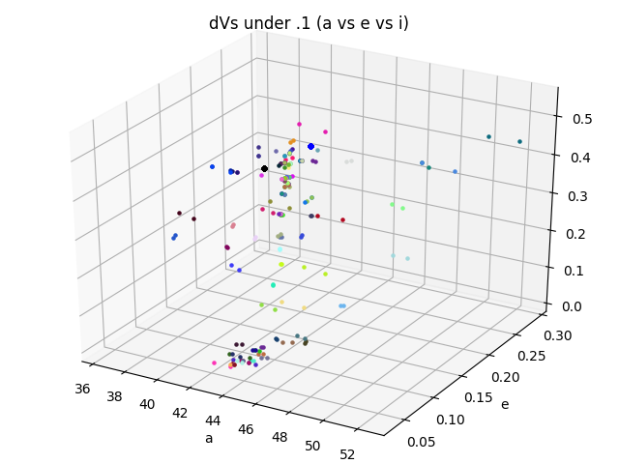
Result: Hierarchical Clustering Algorithm
The top 100 objects with the least dV are displayed to the right. This graph represents how scattered the Kuiper belt is and how difficult it can be to find collisional families. Using this algorithm, no member of the current Haumea family were found. This implies that additional analysis is needed to identify collisional families.
Object 1 | Object 2 | dV Value
2004VT75 | 2007RT15 | 0.00672402049406887
2014YG50 | 2011UR41 | 0.00789975378227958
2011UU41 | 69986 | 0.01020990902767570
2014HT19 | 2014UU22 | 0.01161328016271370
386723 | 416400 | 0.01387207465758520
Oversized blue – center of the Haumea family collision
Oversized black – Haumea planet
Notes:
Mostly used for main belt, recently used for Kuiper belt. Advantage over other clustering algorithms, like k-means clustering algorithm

Slide 13
Conclusions
Reject Hypothesis
Further research is need in development of both Algorithms
Datasets with more objects are needed
More computing power is needed in order to test more iterations of the HCA

Slide 14
References
Bolin, B. T., Delbo, M., Morbidelli, A., & Walsh, K. J. (2017). Yarkovsky V-shape identification of asteroid families. Icarus,282, 290-312. doi:10.1016/j.icarus.2016.09.029
Delbo’, M., Walsh, K., Bolin, B., Avdellidou, C., & Morbidelli, A. (2017). Identification of a primordial asteroid family constrains the original planetesimal population. Science,357(6355), 1026-1029. doi:10.1126/science.aam6036
Dermott, S. F., Christou, A. A., Li, D., Kehoe, T. J., & Robinson, J. M. (2018). The common origin of family and non-family asteroids. Nature Astronomy,2(7), 549-554. doi:10.1038/s41550-018-0482-4
Levison, H. F., Bottke, W. F., Gounelle, M., Morbidelli, A., Nesvorný, D., & Tsiganis, K. (2009). Contamination of the asteroid belt by primordial trans-Neptunian objects. Nature,460(7253), 364-366. doi:10.1038/nature08094
Marcus, R. A., Ragozzine, D., Murray-Clay, R. A., & Holman, M. J. (2011). Identifying Collisional Families In The Kuiper Belt. The Astrophysical Journal,733(1), 40. doi:10.1088/0004-637x/733/1/40
Nesvorný, D., Broz, M., & Carruba, V. (2015). Identification and Dynamical Properties of Asteroid Families. Asteroids IV. doi:10.2458/azu_uapress_9780816532131-ch016
Novaković, B. (2018). Tracing escapees from collisional families. Nature Astronomy,2(7), 528-529. doi:10.1038/s41550-018-0520-2

